Slide 1

Wandering in the Woods Game
Lewis University
Group - 5
Jagadish Sagi
Meghana Priya Lakamana
Navadeep Gottigundala
Vijesh Medikonda

Slide 2
Introduction
The Wandering in the Woods Game is designed to teach children in K-5 school grades fundamental computer science principles, computational thinking, and elementary mathematics with an immersive and interactive GUI-based application.
The scope of this is project is the development of an educational simulation on the desktop with a graphical user interface (GUI).
The game is primarily targeted at K-5 students as a way to improve their understanding of computational and mathematical concepts, although educators or parents may also use it as a way to support collaborative learning in a classroom or home-based environment.

Slide 3
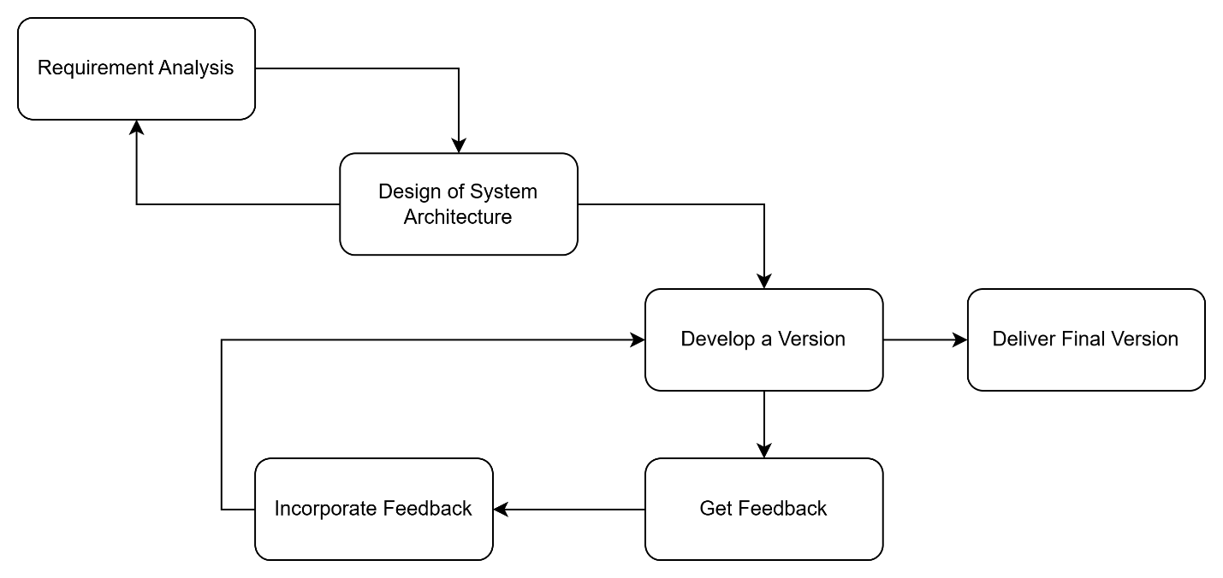
Process model
Evolutionary Process Model

Slide 4
Functional Requirements
Users should be able to launch a new game, choose between the K-2 and 3-5 levels, and configure game settings including the number of participants, grid size, and starting locations for the 3-5 level.
The system must enable players to move within the grid, update their positions, and manage interactions such as merging when players meet.
The system should track and display game statistics, including the longest run without meeting, shortest run, and average run, at the end of each session.
The system must allow users to quit the game from any state and restart the game with the same or new settings.

Slide 5
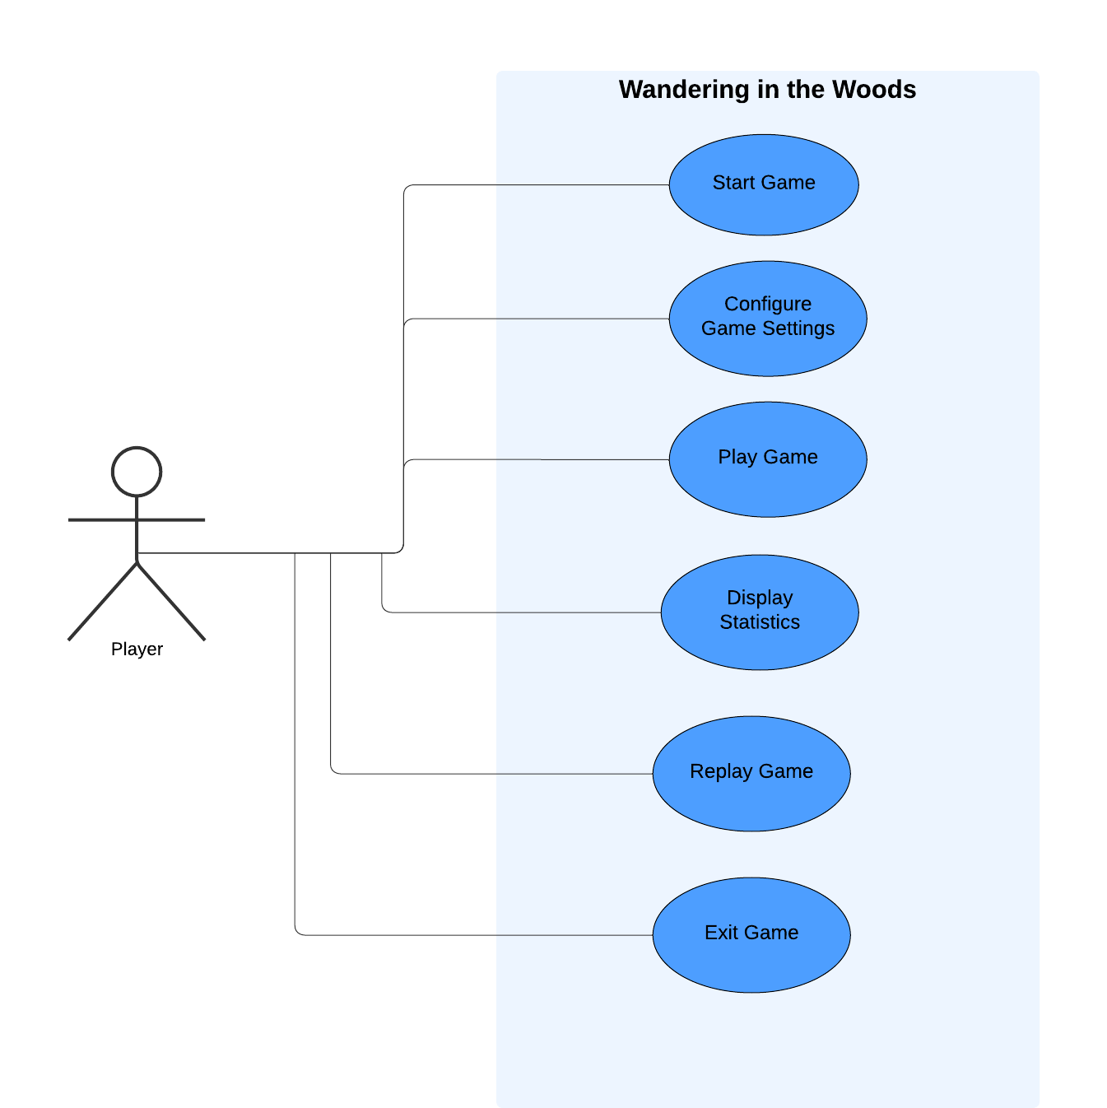
Use case Diagram

Slide 6
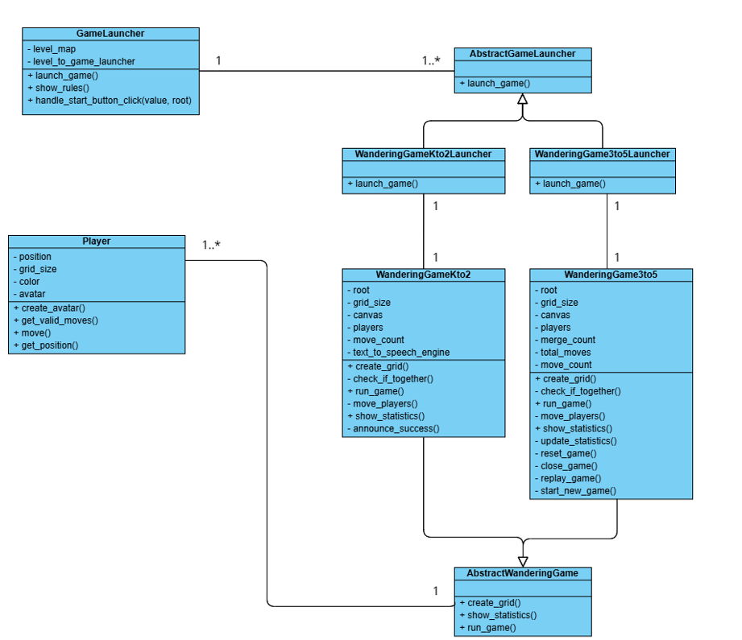
Class Diagram

Slide 7
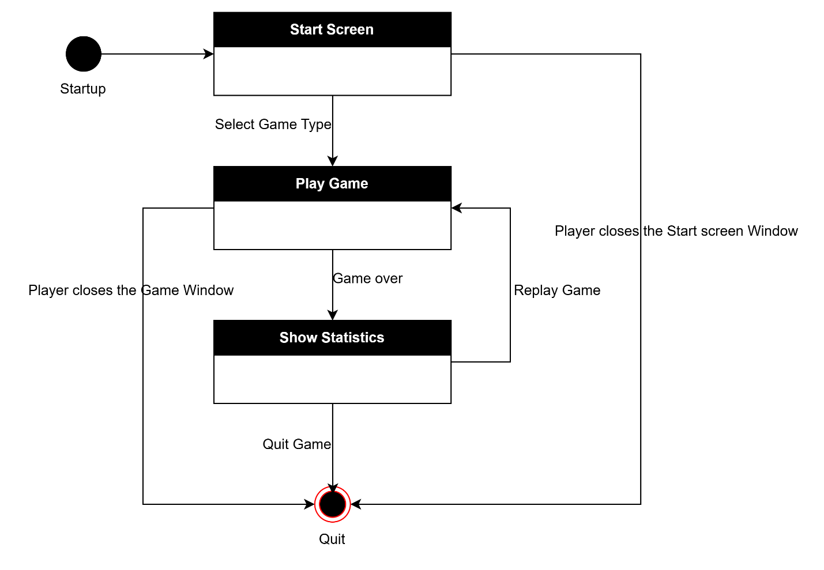
State Diagram

Slide 8
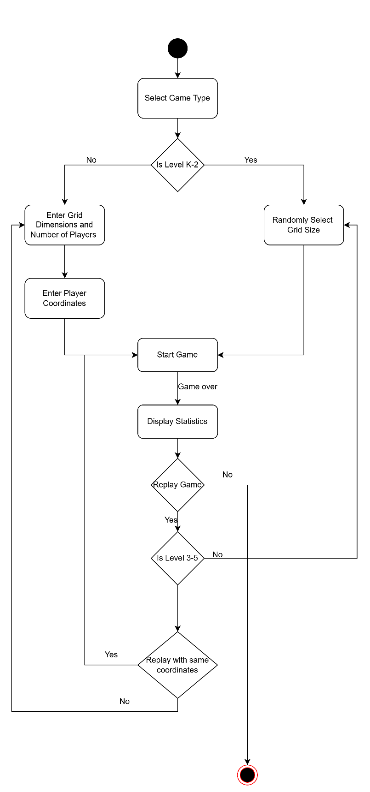
Activity Diagram

Slide 9
Demo

